Slide 1

AngularJS
Shikha Desai

Slide 2
Refer Codeschool_AngularJS_PPTs

Slide 3
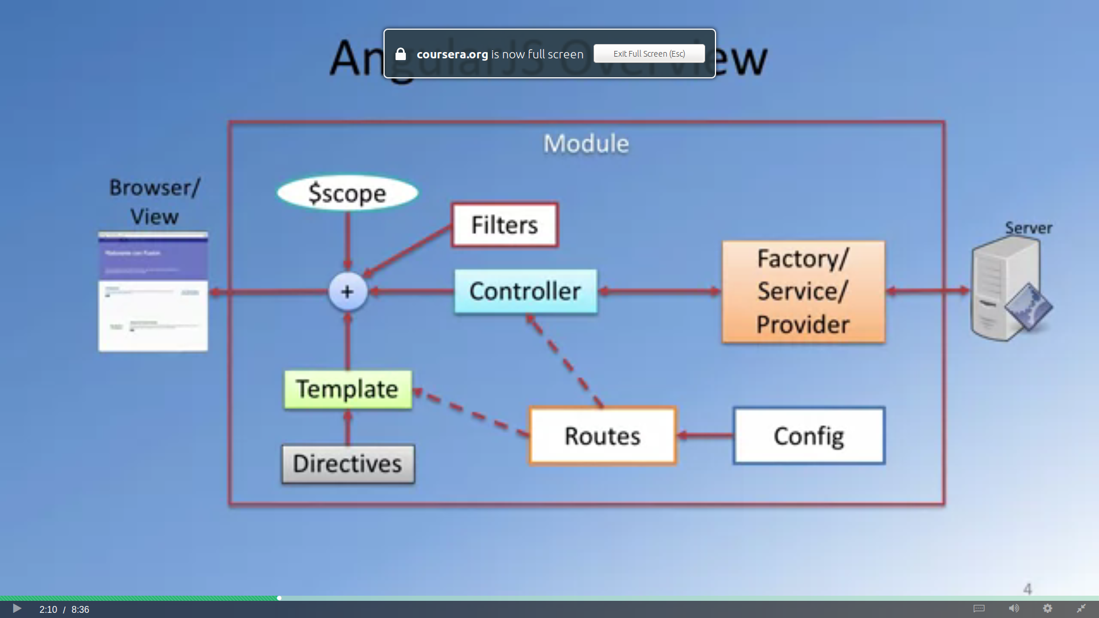
AngularJs ?

Slide 4
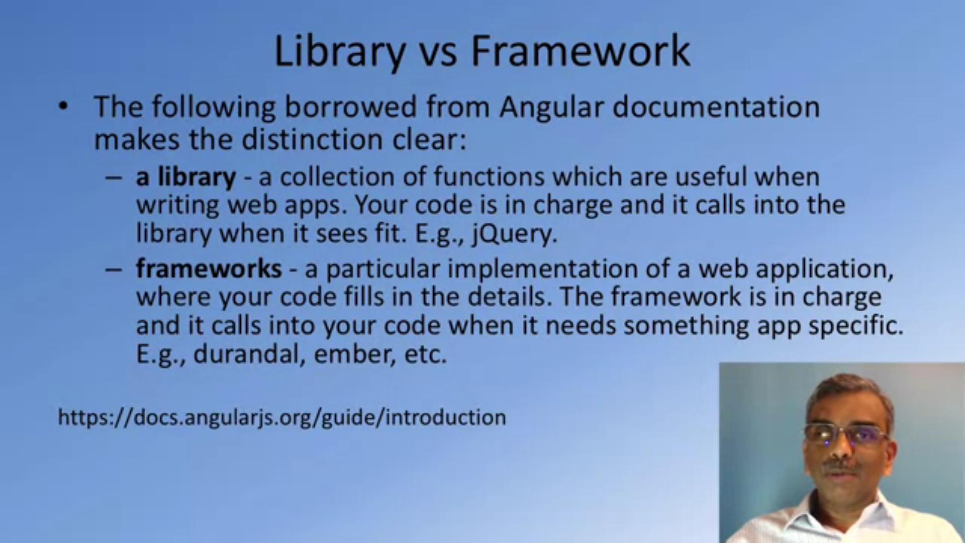

Slide 5
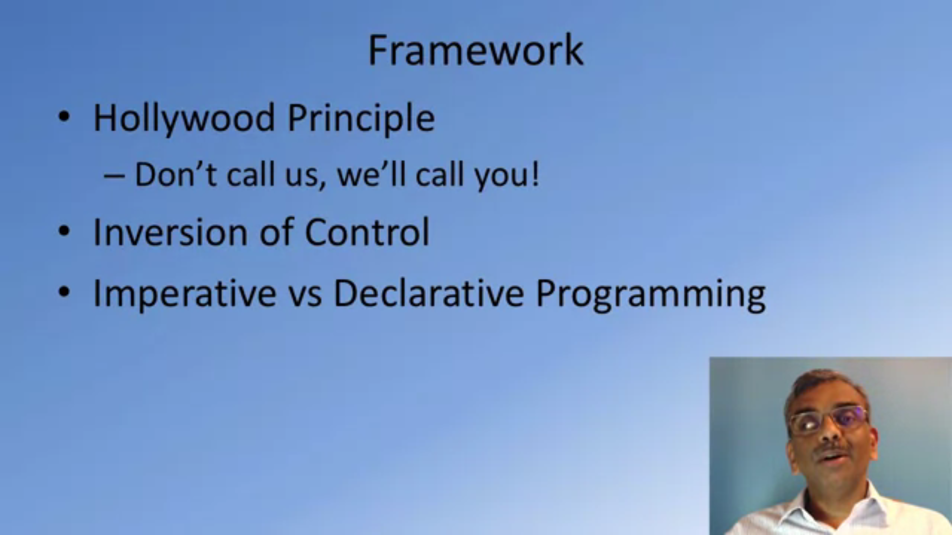

Slide 6

What is AngularJs ?
A client-side JavaScript framework for adding interactivity to HTML
<script src="https://ajax.googleapis.com/ajax/libs/angularjs/1.4.8/angular.min.js"></script>
If we consider an AngularJS application to consist of:
  View, which is the HTML.
  Model, which is the data available for the current view.
  Controller, which is the JavaScript function that makes/changes/removes/controls the data.

Slide 7
ArrayName.length → gives length of array
To get a value in function and set a property to zero is no value passed :
  this.current = value || 0;
Instead of using a variable to store our module, redeclare the module → better practice
<a href=”#”>GoToTop of Page</a>
NgIf
  If the expression assigned to ngIf evaluates to a false value then the element is removed from the DOM, otherwise a clone of the element is reinserted into the DOM.
  NgIf vs ngShow/Hide
    ngIf completely removes and recreates the element in the DOM rather than changing its visibility via the display css property.
    A common case when this difference is significant is when using css selectors that rely on an element's position within the DOM

Slide 8
AngulaJS scope
  Considering MVC, scope is the model
  The scope is a JavaScript object with properties and methods, which are available for both the view and the controller.
  http://www.w3schools.com/angular/angular_scopes.asp

Slide 9
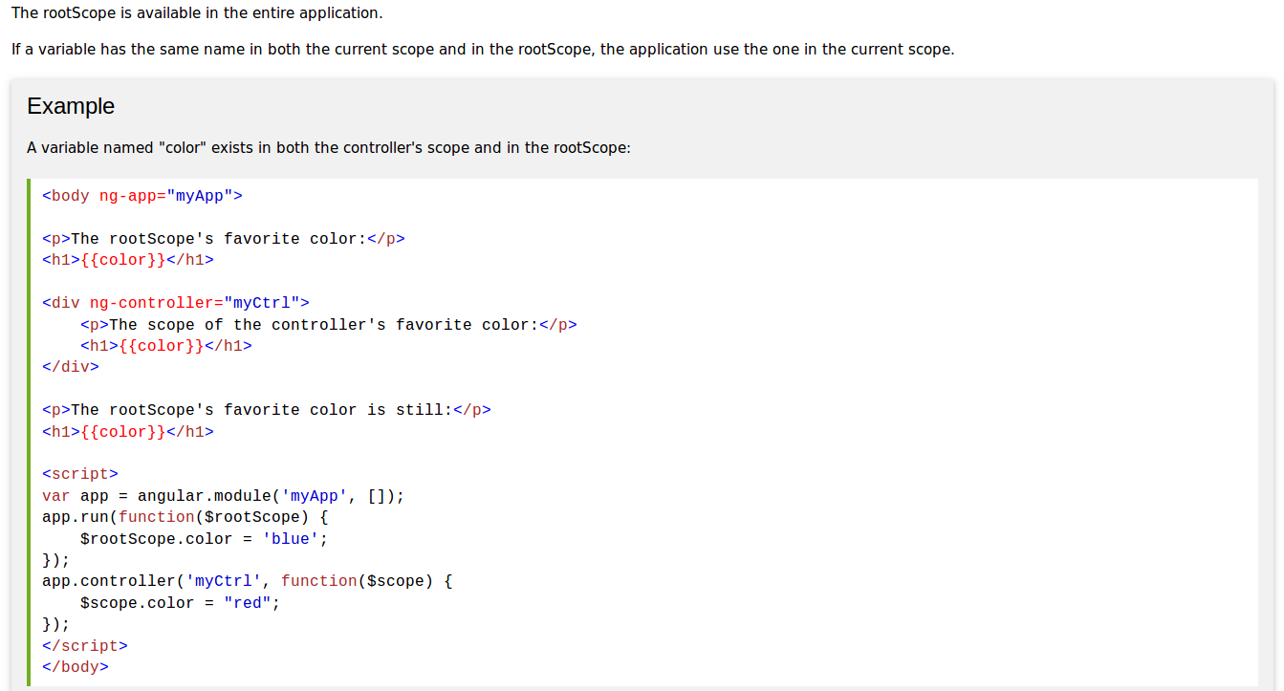
AngulaJS scope

Slide 10
AngulaJS Validation
  http://www.w3schools.com/angular/angular_validation.asp

Slide 11
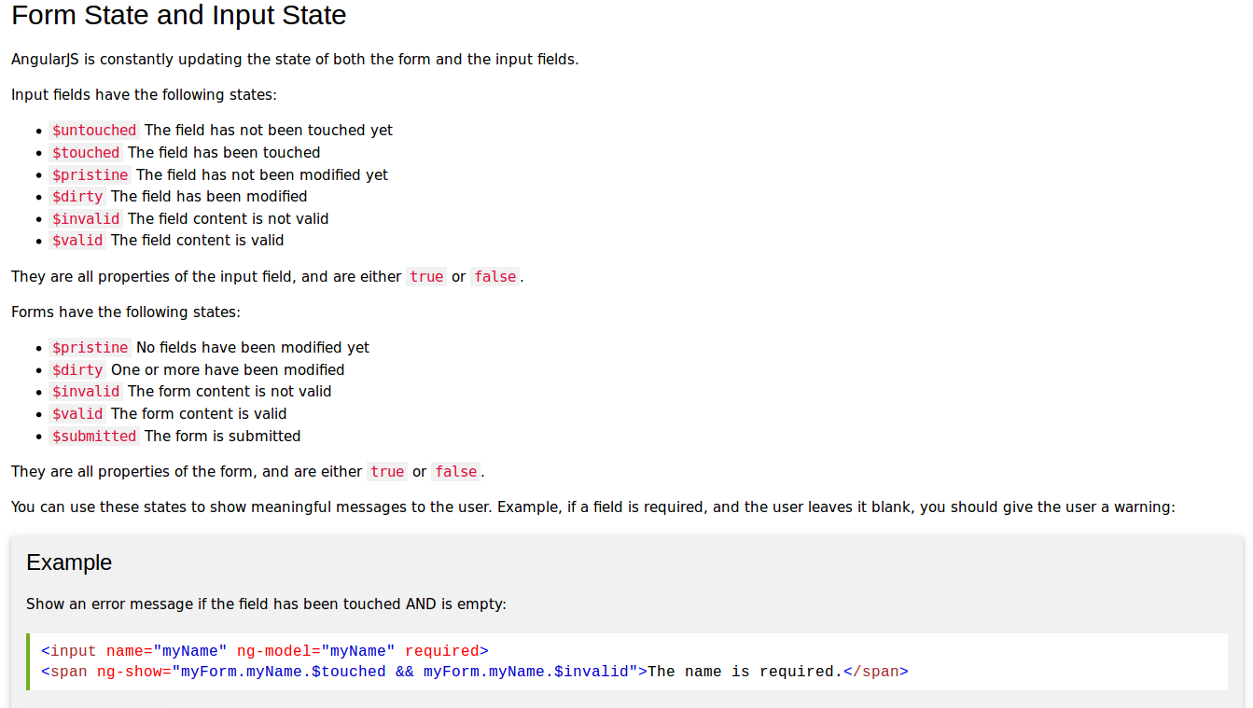

Slide 12
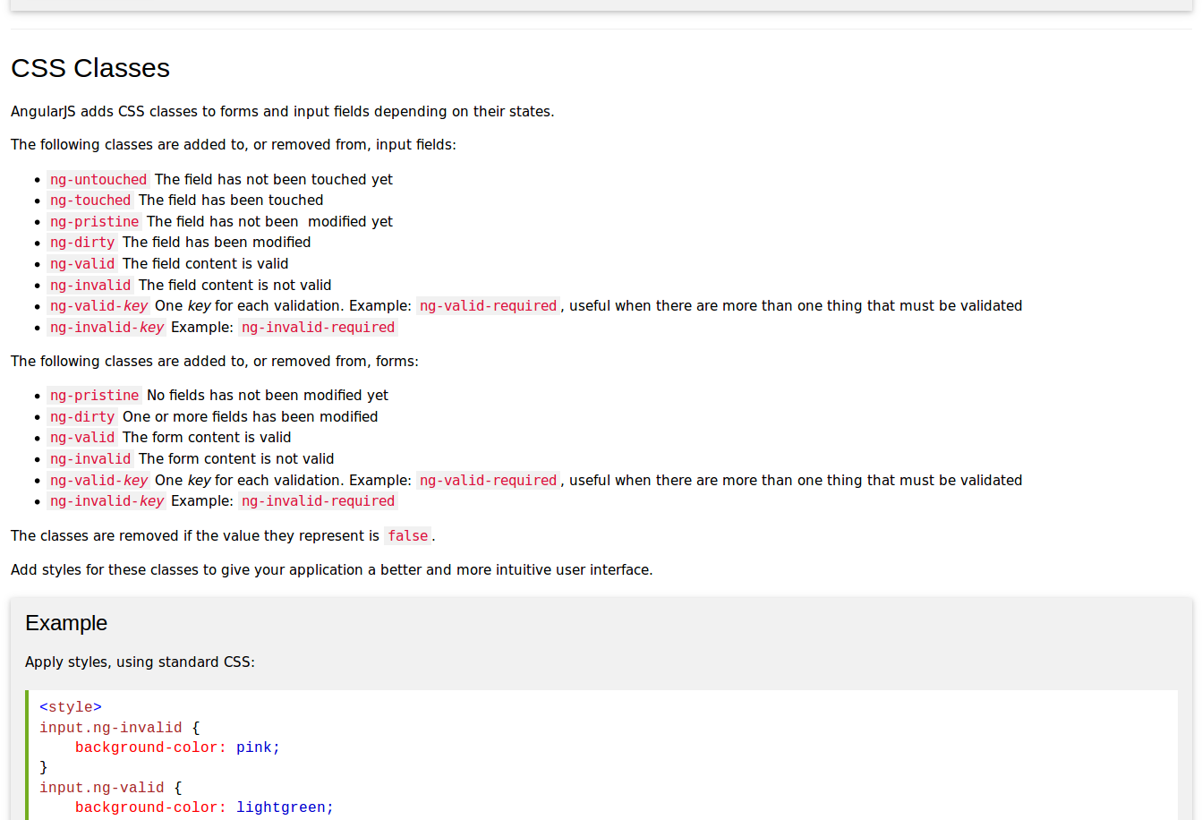

Slide 13
AngularJS Factory, Service and Dependency Injection
  http://viralpatel.net/blogs/angularjs-service-factory-tutorial/

Slide 14
Angular UI-Router
  ui-router is a 3rd-party module and is very powerful. It supports everything the normal ngRoute can do as well as many extra functions.
  ui-router allows for nested views and multiple named views. This is very useful with larger app where you may have pages that inherit from other sections.
  ui-router allows for you to have strong-type linking between states based on state names. Change the url in one place will update every link to that state when you build your links with ui-sref. Very useful for larger projects where URLs might change.
  There is also the concept of the decorator which could be used to allow your routes to be dynamically created based on the URL that is trying to be accessed. This could mean that you will not need to specify all of your routes before hand.
  states allow you to map and access different information about different states and you can easily pass information between states via $stateParams.
  You can easily determine if you are in a state or parent of a state to adjust UI element (highlighting the navigation of the current state) within your templates via $state provided by ui-router which you can expose via setting it in $rootScope on run.

Slide 15
Angular UI-Router
  https://github.com/angular-ui/ui-router/wiki
  State :
    A state corresponds to a "place" in the application in terms of the overall UI and navigation.
      $stateProvider.state('contacts', {
      template: '<h1>My Contacts</h1>'
      })
    States often have things in common, and the primary way of factoring out these commonalities in this model is via the state hierarchy, i.e. parent/child states aka nested states.
      $stateProvider
      .state('contacts', {})
      .state('contacts.list', {});
      OR
      $stateProvider
      .state('contacts', {})
      .state('list', {
      parent: 'contacts'
      });

Slide 16
Angular UI-Router
  Including a state :
    <body ng-controller="MainCtrl">
    <section ui-view></section>
    </body>
  There are three main ways to activate a state:
    Call $state.go(). High-level convenience method.
    Click a link containing the ui-sref directive.
    Navigate to the url associated with the state.

Slide 17
Angular UI-Router
  Multiple views
    <!-- index.html -->
    <body>
    <div ui-view="filters"></div>
    <div ui-view="tabledata"></div>
    <div ui-view="graph"></div>
    </body>
    $stateProvider
    .state('report', {
    views: {
    'filters': { ... templates and/or controllers ... },
    'tabledata': {},
    'graph': {},
    }
    })

Slide 18
Angular UI-Router
  URL Routing
    $stateProvider
    .state('contacts', {
    url: "/contacts",
    templateUrl: 'contacts.html'
    })

Slide 19
AngularJS + REST
  http://blog.brunoscopelliti.com/building-a-restful-web-service-with-angularjs-and-php-more-power-with-resource/

Slide 20
URL to be refered for angular api :
  https://docs.angularjs.org/api
Tutorials link
  https://egghead.io/
  https://thinkster.io/

